Slide 1
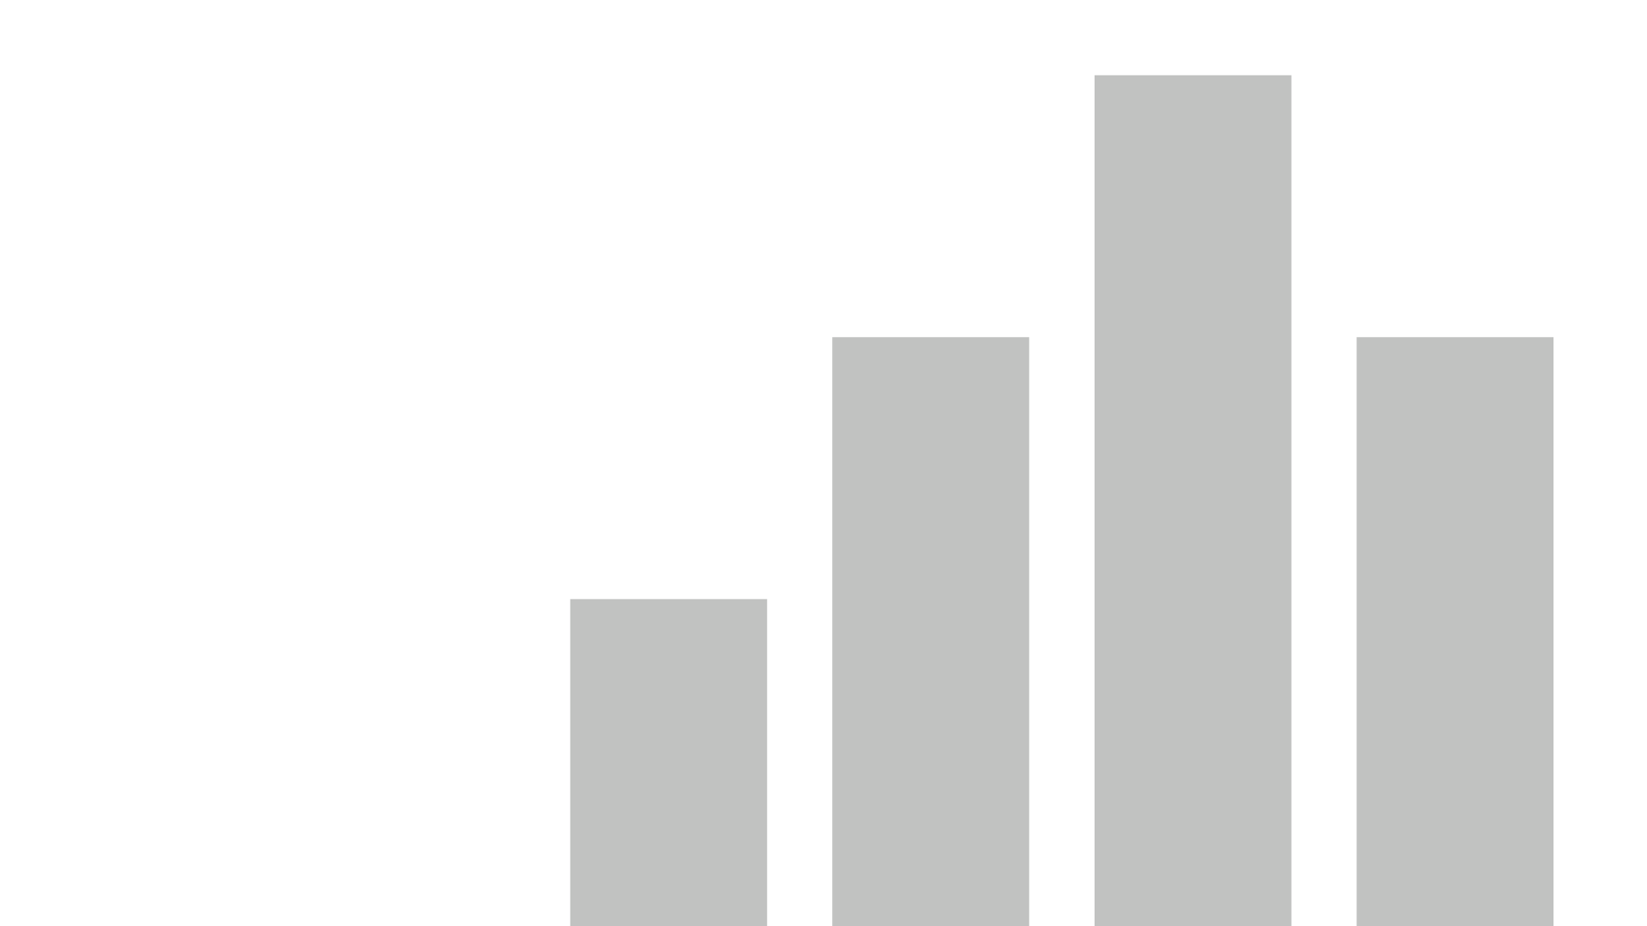


Visualization
View in Power BI
Last data refresh:
2/27/2022 11:00:44 PM UTC
Downloaded at:
2/27/2022 11:01:38 PM UTC

Slide 2
Data Visualization Using PowerBI case study: ACME Pharmaceutical HR Visualization DATA 220 ASSIGNMENT 3 PROF DAVE LINESH
The purpose of this exercise is to exercise analyze the employee data. The report will
be presented to . The Chief Executive Officer (CEO), Chief Operations Officer (COO),
Chief Financial Officer (CFO) of the organization, to help them understand the
characteristics of employees that are more likely to leave the company . We will bring
the conclusion , which can help the company to improve their employee retention.

Slide 3
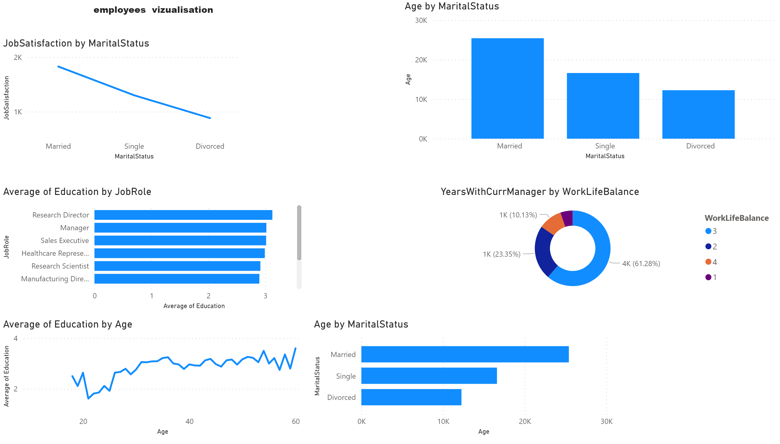
Page 1
Notes:
textbox
Data visualization. Compare some case base on data we have .
lineChart
We used line chart to see the trend of job satisfaction compared to marital status. We can see clearly see that married employees are more satisfied with their job than divorced. That can lead them to quick their job.
clusteredColumnChart
Here we compare job role to employee's education. We can see that the more educated people occupy the higher functions.
clusteredBarChart
We used the bar char chart to show how statistically Marital status vary by age . As we can see older people tend to be less single.
donutChart
The year spent under the same manager can impact employee's decision to stay or leave the company. We compare that to work life balance since we have less than 5 categories number to compare. We can see the majorities of employees like their life under current manager, because he give them more flexibility to balance their life and work.
lineChart
Here we are checking the average education age. The chart help us to see the evolution of the employees compare to their education. Employees in the late 40 are more educted.
clusteredBarChart
We used the bar char chart to show how statistically Marital status vary by age . As we can see older people tend to be less single.

Slide 4
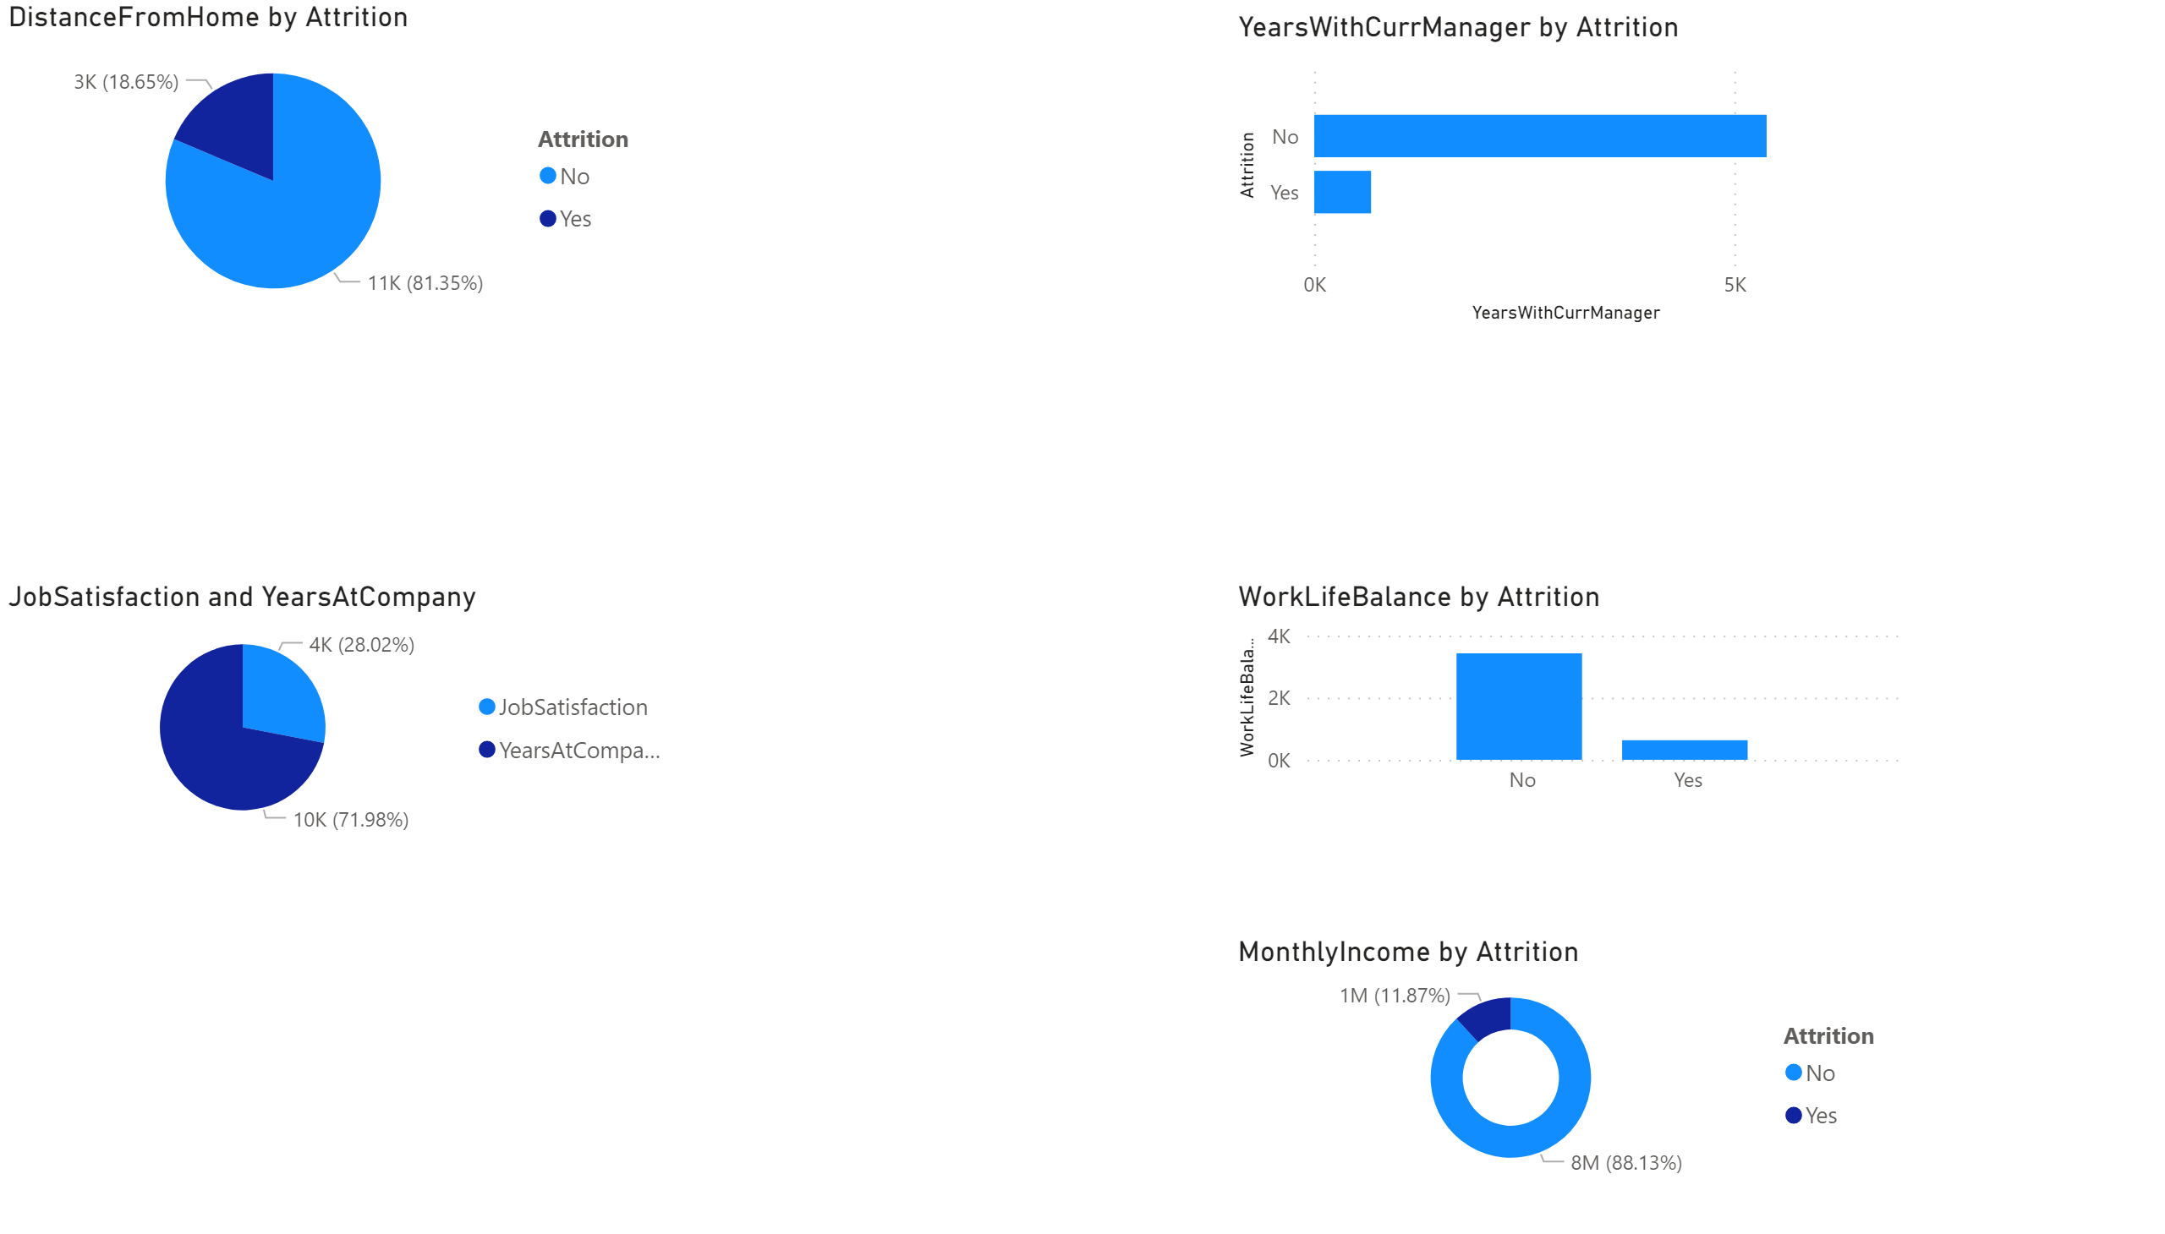
Page 2
Notes:
pieChart
Her we work more with attrition to get a closer answer from employee. Pie chart is easier to see the impact of distance from home on employee attitude. We can clearly see that distance from home is not the key factor for employees to leave.
barChart
The bar Chart show us the years spent under the current manager do not affect employee's decision to leave
pieChart
The employees tend to be less satisfied by their jobs with the time. We can see that on the pie chart
clusteredColumnChart
we can see that work balance affected employee's decision to stay or leave. We can see that people are tend less to leave the company when the work life balance is high.
donutChart
Monthly income is another factor that we use to check employees decisions.

Slide 5
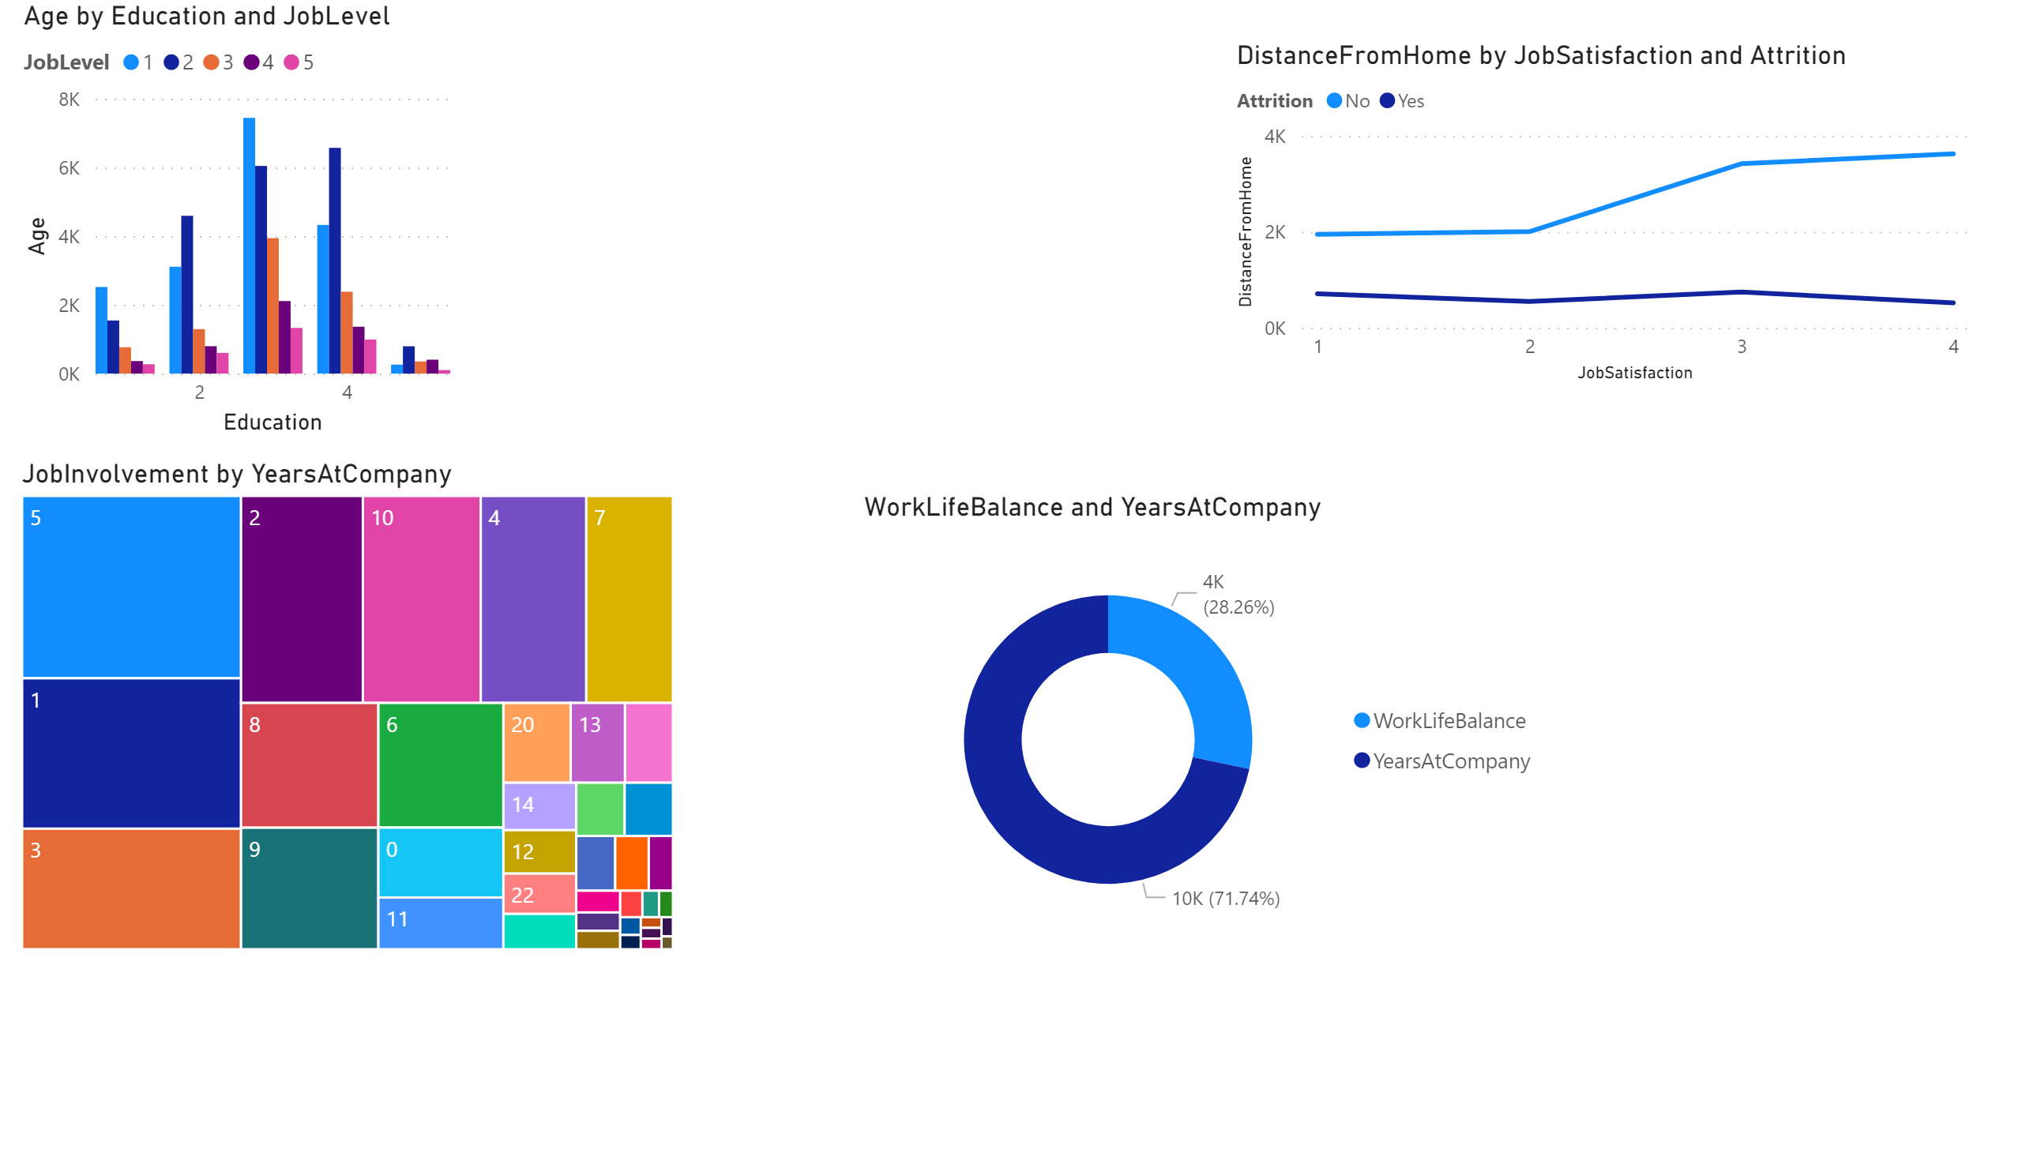
Page 3
Notes:
clusteredColumnChart
We use this chart to have more view on three factors(age, education, job) that can influence employees' decision.
treemap
Tree map is one of the good chart for visualization. Here we want to see the job involvement in the company compared to year at the company.
lineChart
As we said earlier, distance from home affected the job satisfaction. W e can clearly see that close are more satisfied with their job
donutChart
Years spent at the company affected also life of our employees. So that can be another factor that influence employee decision to leave or stay.

Slide 6
Recommandations for the company
After review the visualizations, we mentioned some factor that can affected employees' decisions to leave or stay. W can propose some recommendations to Acme Pharmaceutical Company.
Marital status impact employees' envy to stay or leave. Company will encourage many of his employees to get married or to hire more married employees. We see from the visualizations that single and divorced employees tend tom leave the company easily . Their work life balance is less stable.
Distance from home affected also employee's decision. More closer employees are to the company , it become easy to balance work and life. Company should encourage employees to relocate close the site.

Slide 7
Recommandations
Employees tend to be more involved in their when they spent more time in the company , and year under the current manager. We should recommend the company to reinforce the relationship between employees and the current manager, and offer more benefit to every employees that will help him stay more in the company.

